Slide 1

Introduction to
Bhavesh Anand
College of Technology, pantnagar

Slide 2

About Me
Final year student at College of Technology, Pantnagar
Open Source Contributor at Fossasia, Kivy, Melissa

Slide 3
Outline
Background
Syntax
Types
Operators
Control Flow
Functions
SymPy

Slide 4
Background

Slide 5
Multi-purpose (Web, GUI, Scripting, etc.)
Object Oriented
Interpreted
Strongly typed and Dynamically typed
Focus on readability and productivity

Slide 6
Syntax

Slide 7
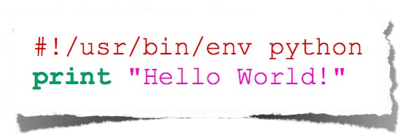
Hello World
any_var = input ()

Slide 8
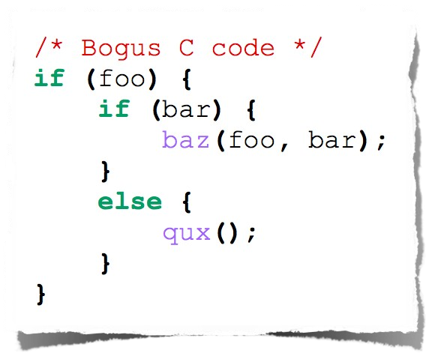
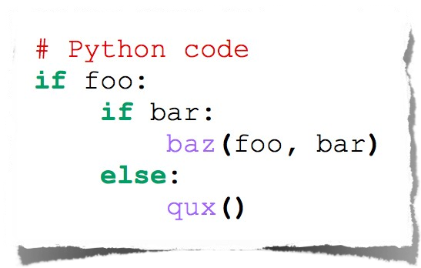
Indentation

Slide 9
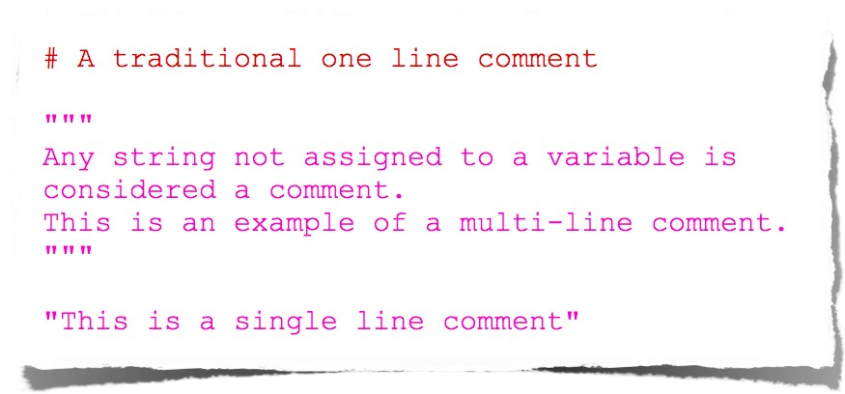
Comments

Slide 10
Types

Slide 11
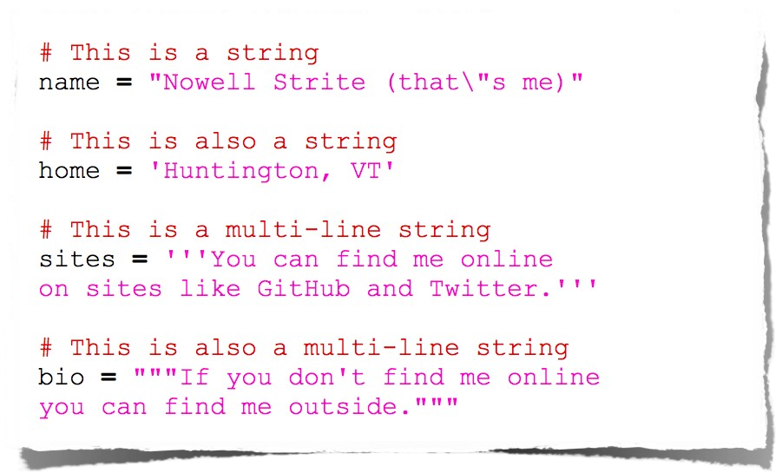
String

Slide 12
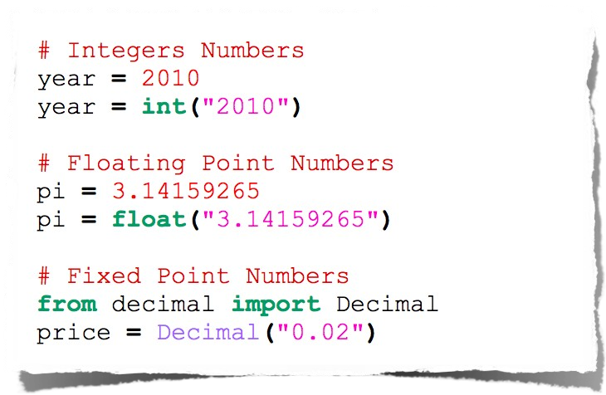
Number

Slide 13

Null

Slide 14
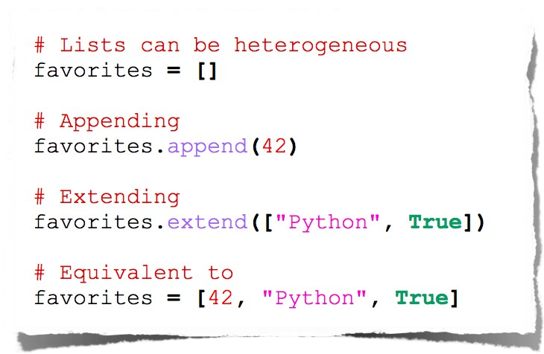
List

Slide 15
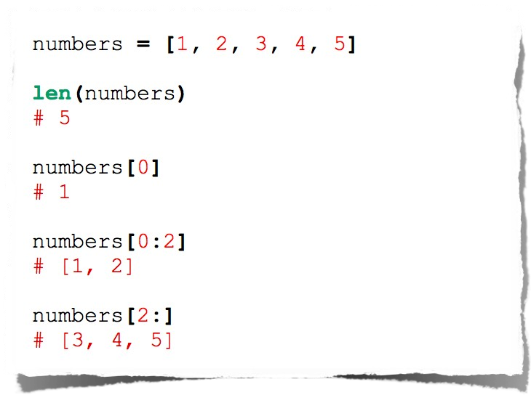
List

Slide 16
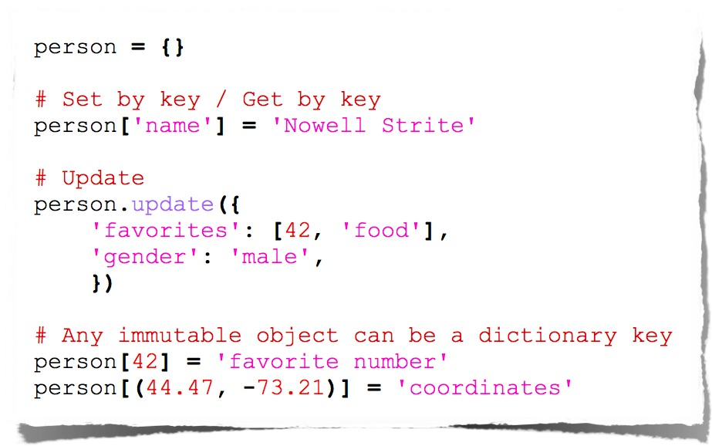
Dictionaries

Slide 17
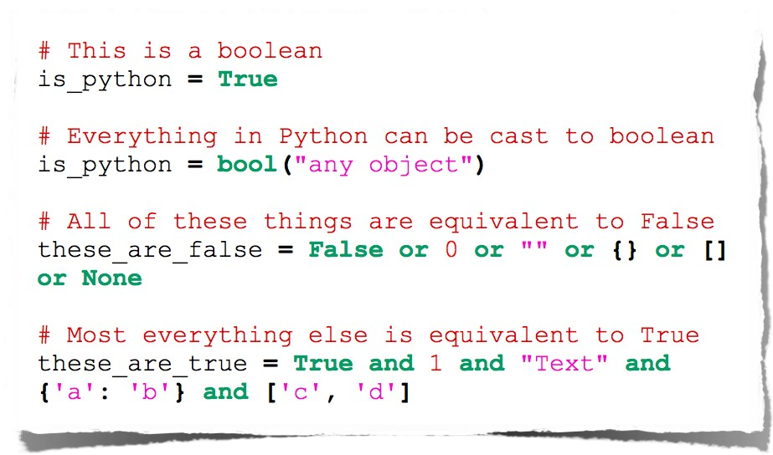
Booleans

Slide 18
Operators

Slide 19
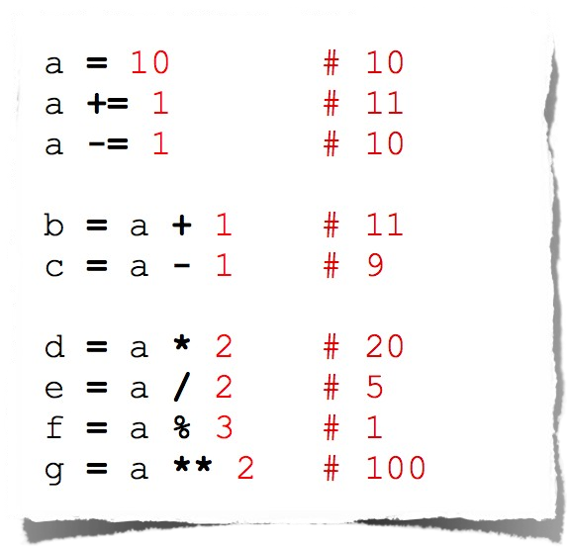
Arithmetic Manipulation

Slide 20
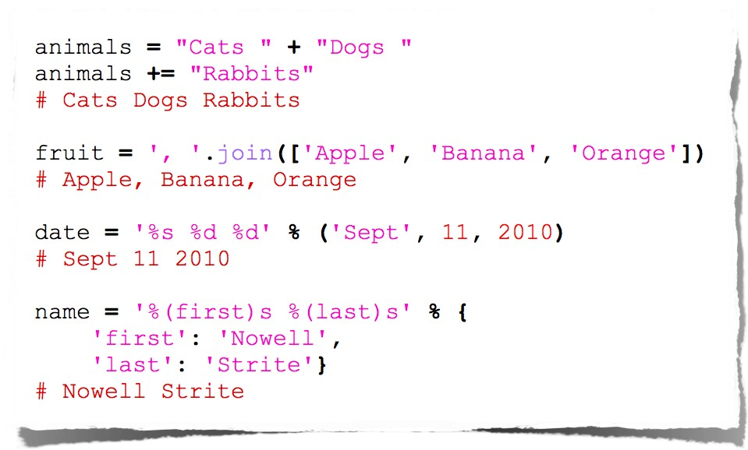
String Manipulation

Slide 21
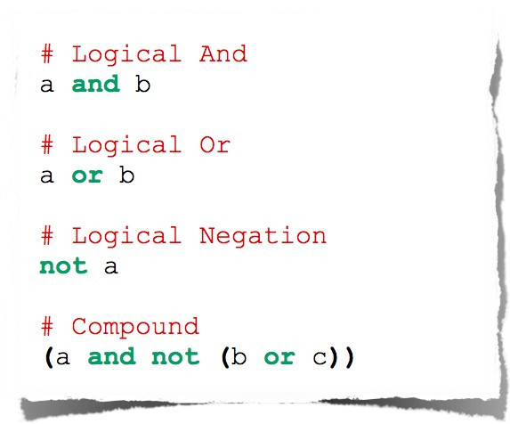
Logical Comparison

Slide 22
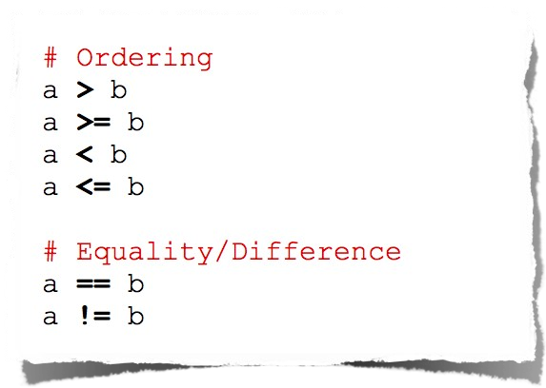
Arithmetic Comparison

Slide 23
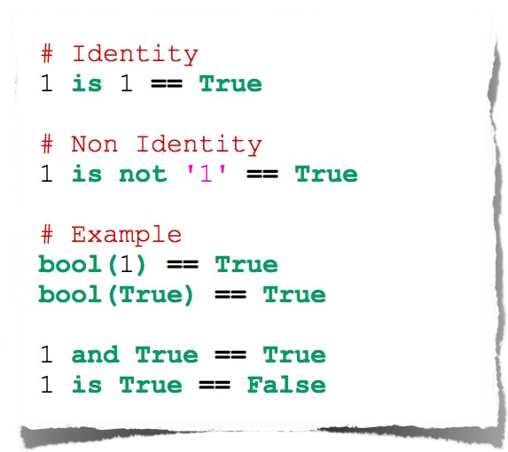
Identity Comparison

Slide 24
Control Flow

Slide 25
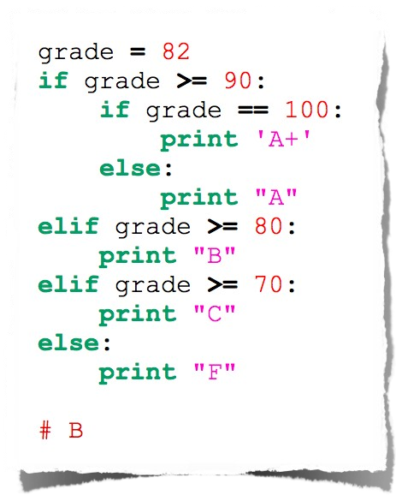
Conditionals

Slide 26
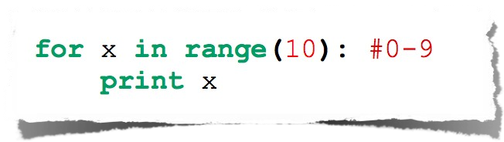
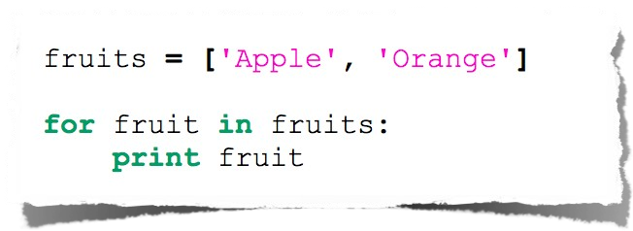
For Loop

Slide 27
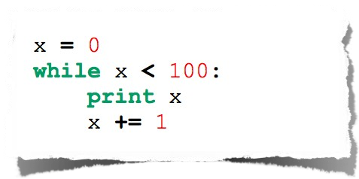
While Loop

Slide 28
Functions

Slide 29

Basic Function

Slide 30
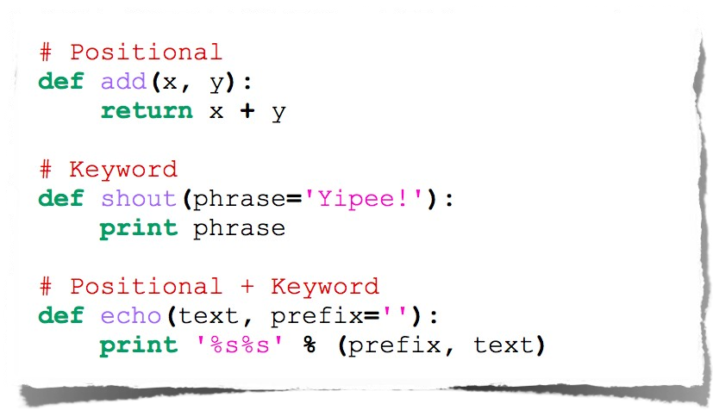
Functions with arguments

Slide 31
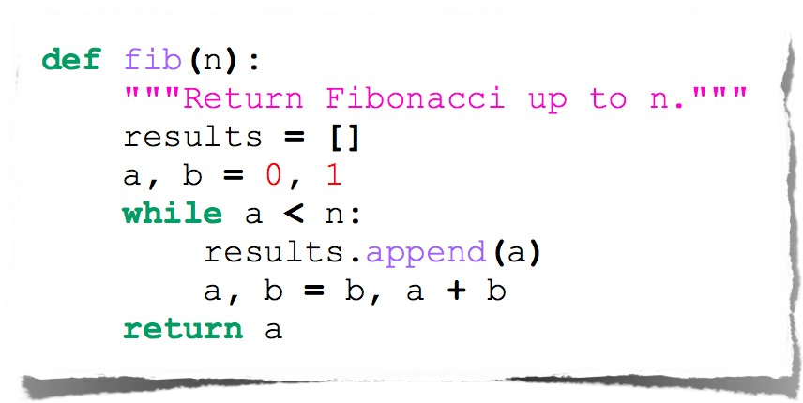
Fibonacci

Slide 32
SymPy

Slide 33
Features
SymPy is a Python library for symbolic mathematics
Limits: limit(x*log(x), x, 0) -> 0
Differentiation
Integration: It uses extended Risch-Norman heuristic
Taylor (Laurent) series
Polynomial equations
Algebraic equations
Differential equations
Difference equations
Systems of equations

Slide 34
Symbols
from sympy import Symbol, pprint
def main():
a = Symbol('a')
b = Symbol('b')
c = Symbol('c')
e = ( a*b*b + 2*b*a*b )**c
print('')
pprint(e)
print('')
if __name__ == "__main__":
main()

Slide 35
Differentiation
import sympy
from sympy import pprint
def main():
a = sympy.Symbol('a')
b = sympy.Symbol('b')
e = (a + 2*b)**5
print("\n\nDifferentiating w.r.t. a:")
print()
pprint(e.diff(a))
print("\n\nDifferentiating w.r.t. b:")
print()
pprint(e.diff(b))
if __name__ == "__main__":
main()

Slide 36
Thank you

